Slide 1
Why Libraries?
A reason for them
& their staff…

Slide 2
When you want this
The information you want

Slide 3
From this

Slide 4
You can go here

Slide 5
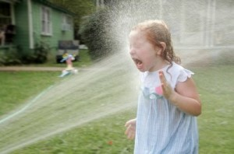
And get this

Slide 6
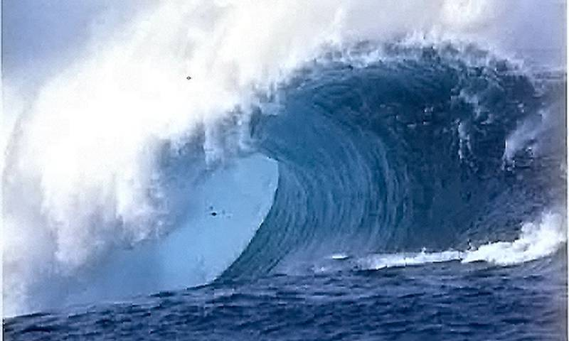
Or this

Slide 7
Can result in this

Slide 8
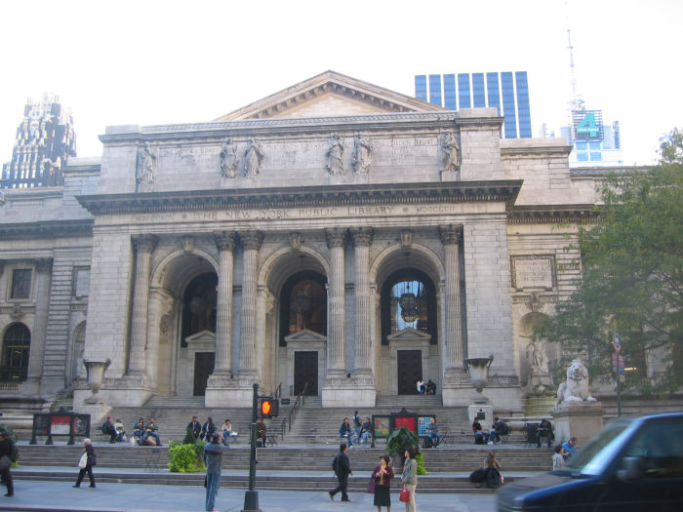
You can go here instead
( A Public Library )

Slide 9
Talk with these folks

Slide 10
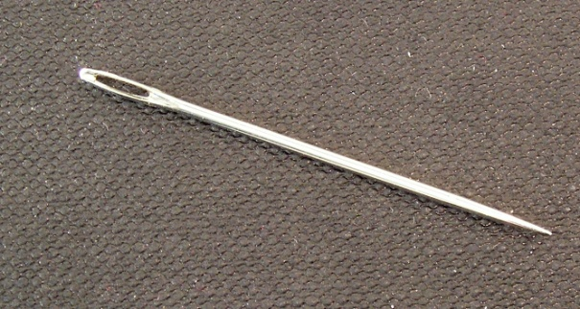
Who can look at this
and find
this…

Slide 11
Resulting in this…

Slide 12
Therefore, let us introduce…

Slide 13
An Introduction for your library
Created by
Mr. Leif Madsen, MLS
LRC Manager, Denver School of Nursing
&
Ms. Tamara Kirch
MLIS Candidate, Univ. of Denver
@ 2012 CAL Conference, Keystone, CO

